Slide 1
Load.in
Give your move a game plan.
Team Yellow
Feasibility Presentation
Old Dominion University
9/26/2020
Notes:
This slide is a non-animated version of the following slide. (Title Slide)

Slide 2
Load.in
Give your move a game plan.
Team Yellow
Feasibility Presentation
Old Dominion University
9/23/2020
Notes:
This slide is an animated version of the previous slide. (Title slide)

Slide 3
Contents
Team Biography: 4
The Problem: 5
Problem Statement: 9
Problem Characteristics: 11-16
Current Process Flow: 17-19
Major Functional Component Diagram: 20-21
Competition: 22-23
References: 24
Glossary: 25

Slide 4







Who is Team Yellow?
Byron Aquilino
Lance Perdue
Greg Kukanich
Jason Moran
Daniel Reyna
Chris Miller
Paul Rodriguez

Slide 5
“Do It Yourself” movers lack the expert knowledge required to handle the logistics of their move.

Slide 6


Slide 7
Professional Movers Are Costly
Notes:
https://www.hireahelper.com/movers-academy/on-the-job/estimating-job-times/
https://www.uhaul.com/Reservations/RatesTrucks/
https://www.move.org/average-cost-truck-rental/
https://www.victoryvan.com/moving-and-storage/how-long-takes-move-new-house
https://www.movers.com/moving-guides/moving-four-bedroom-house-costs.html

Slide 8
Loading a truck properly requires many considerations including weight distribution and protecting fragile items.
PenskeTruckRental.com

Slide 9
Accurately determining how big of a truck to get and how many trips a move will take is difficult. Rental Truck companies base their business model on this!
wtkr.com

Slide 10
Poor packing can result in property damage and in the worst case, a car accident. An estimated 50,000 accidents related to trailer towing occur each year.
Hayesbc.com

Slide 11
What is the current process?

Slide 12
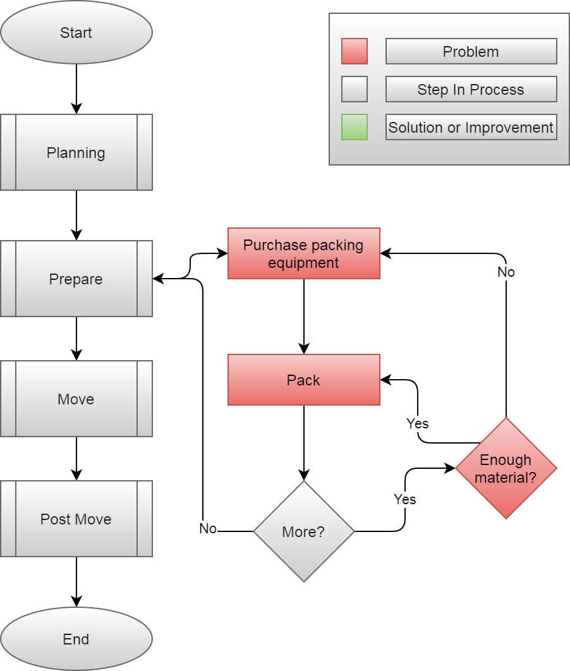

Slide 13
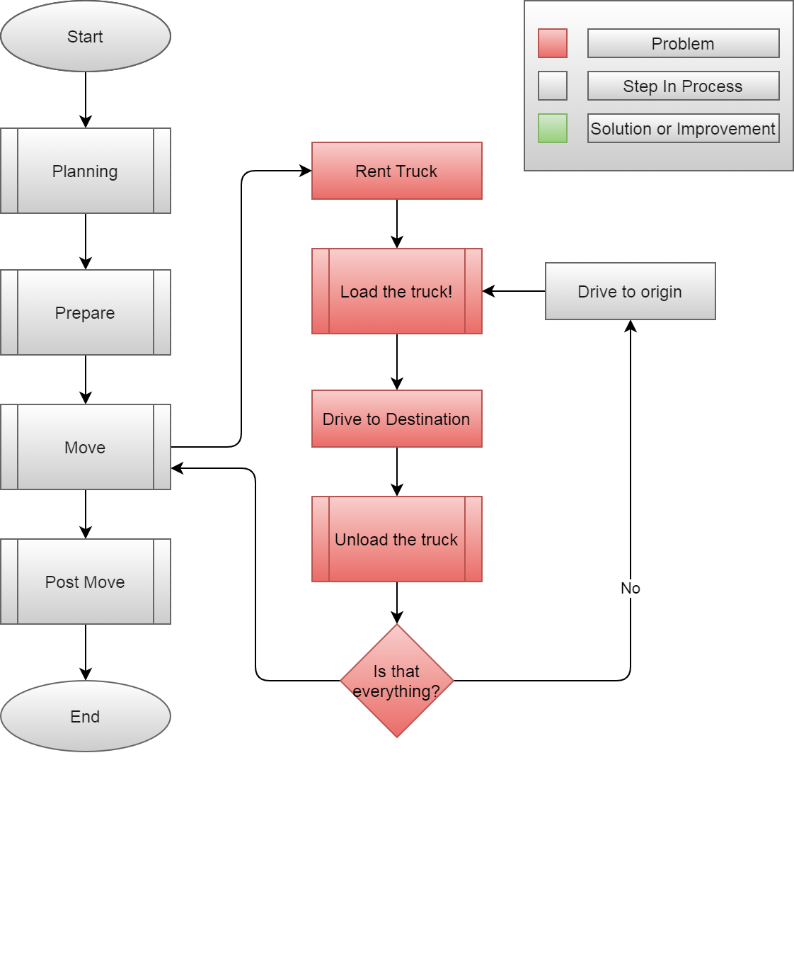

Slide 14
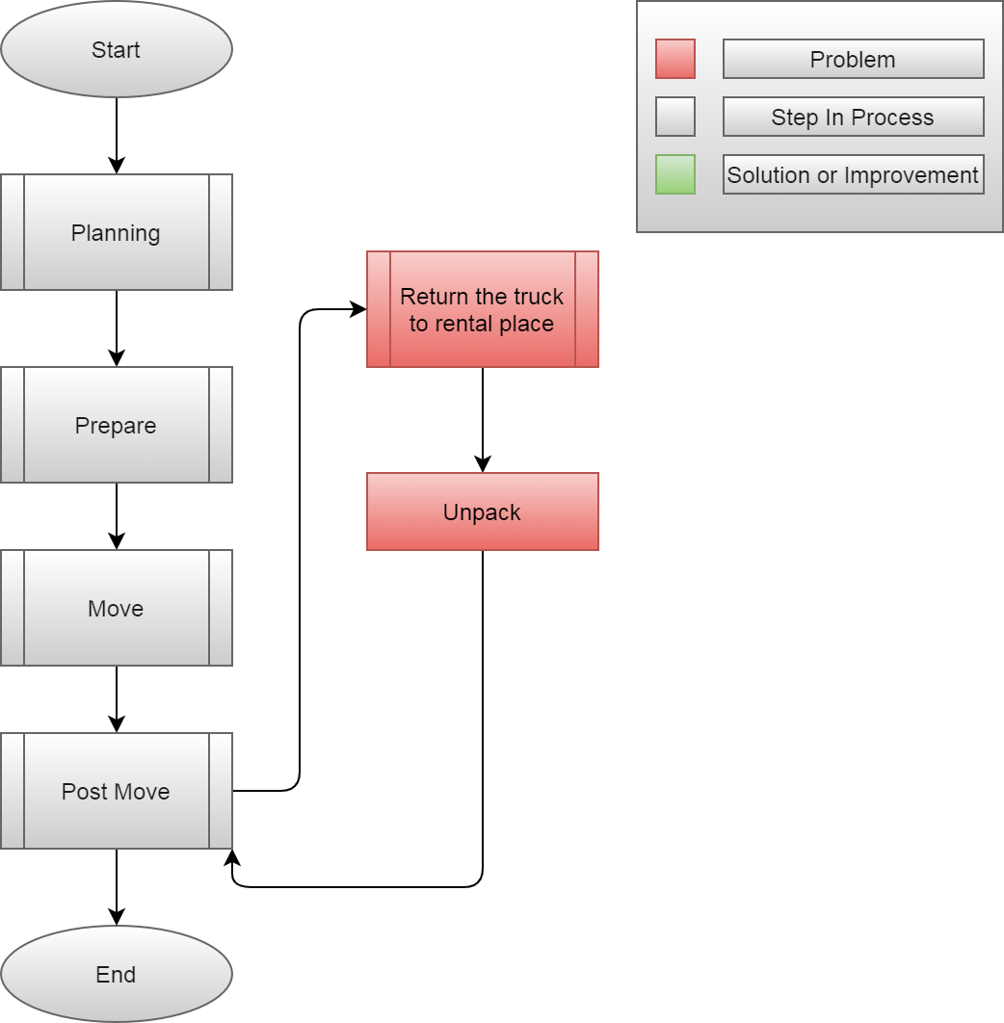

Slide 15
Solution Definition

Slide 16
Load.In gives your move a game plan by using artificial intelligence and computer vision to provide expert-level instructions, tips and tricks on moving day.

Slide 17
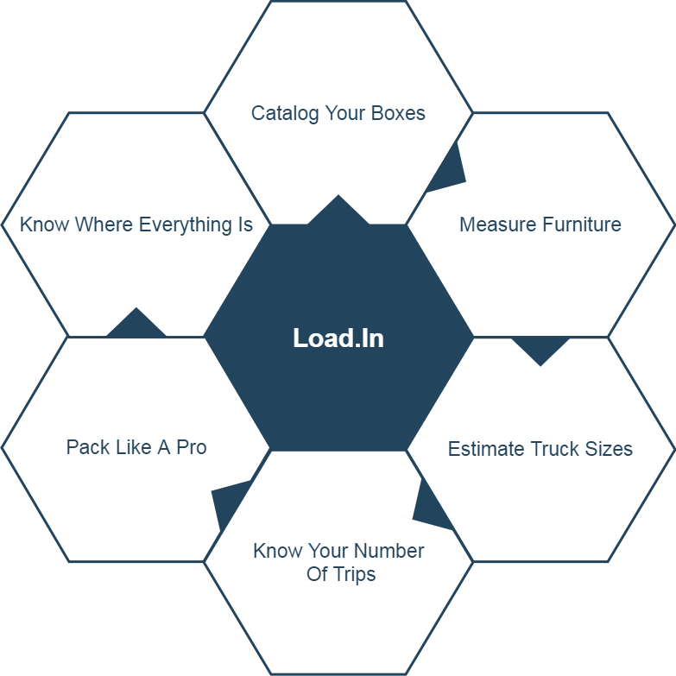
Solution Characteristics

Slide 18
How will the solution help the process?

Slide 19
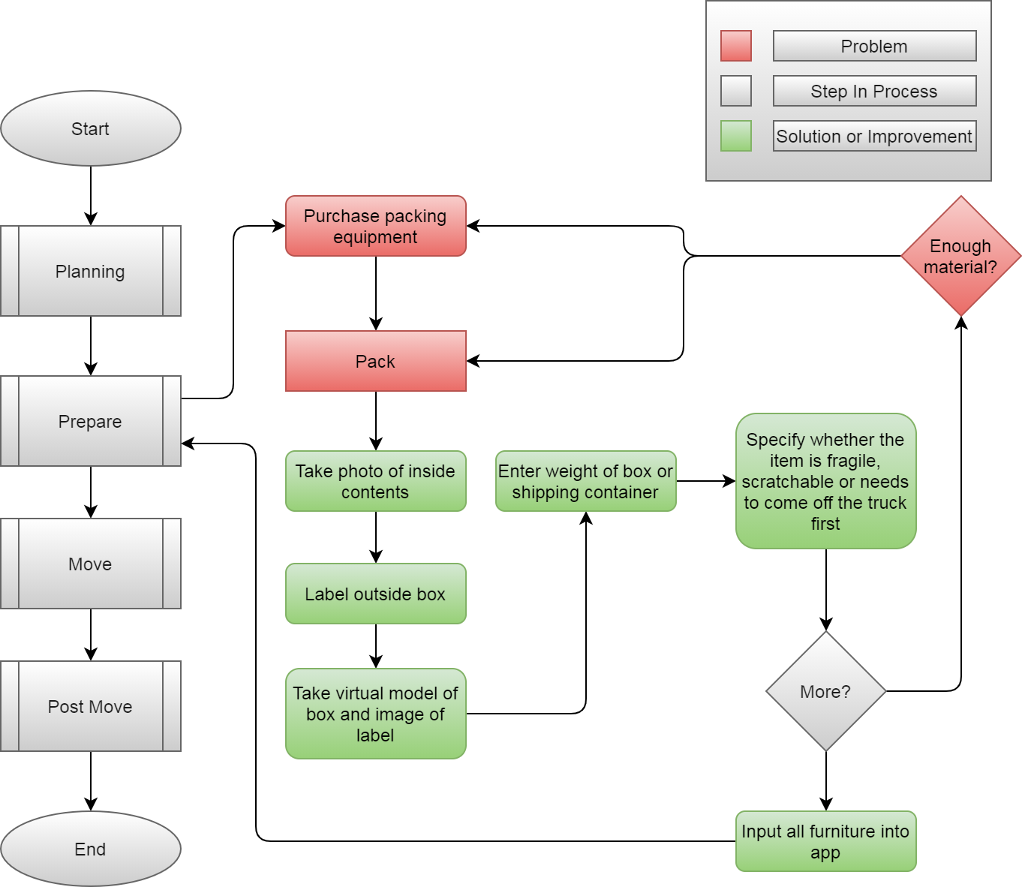

Slide 20
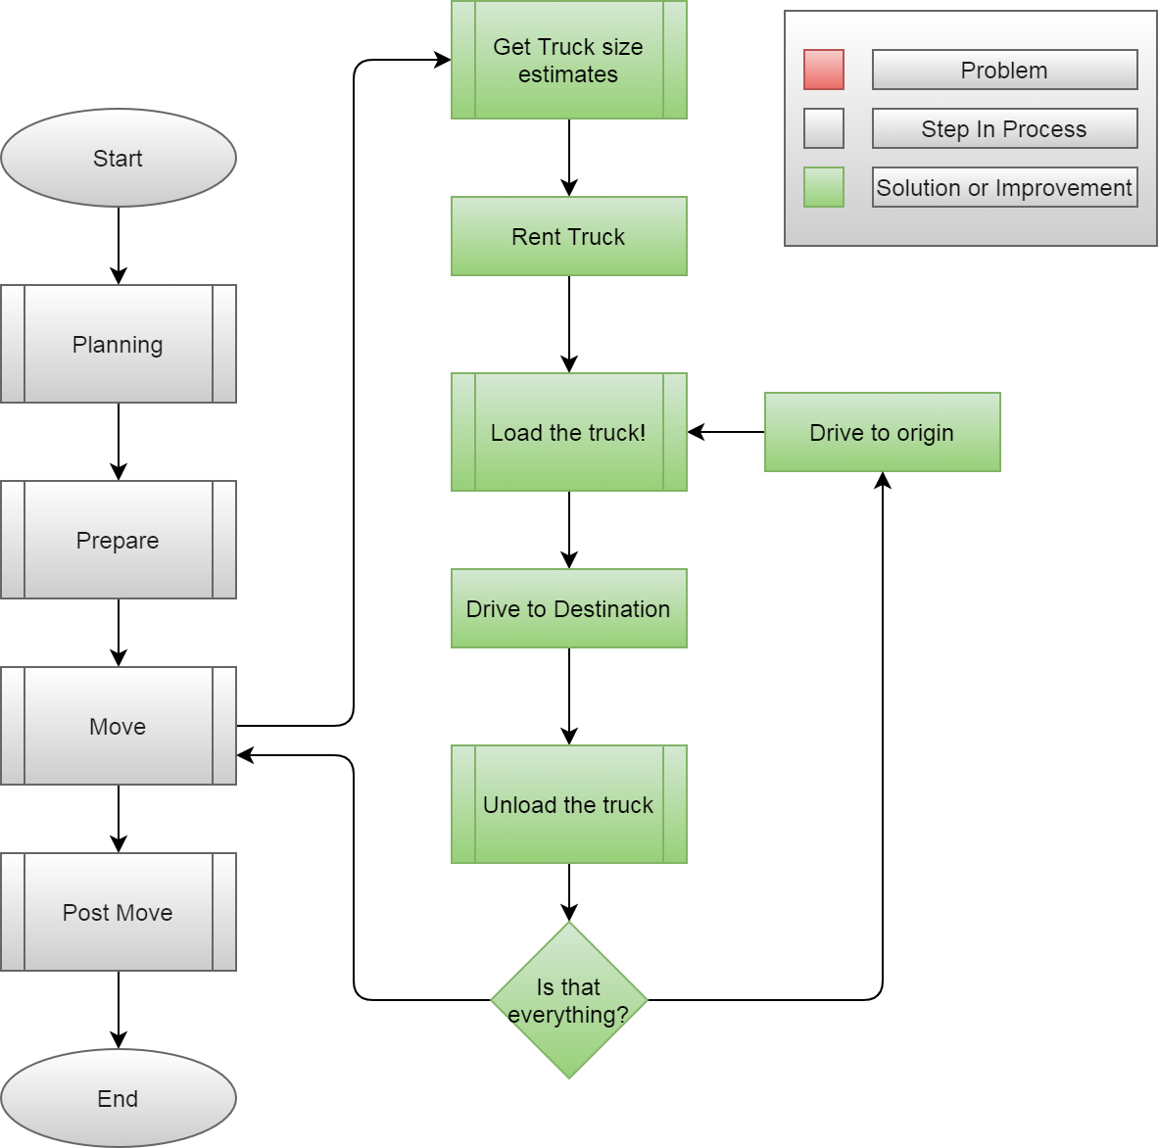

Slide 21
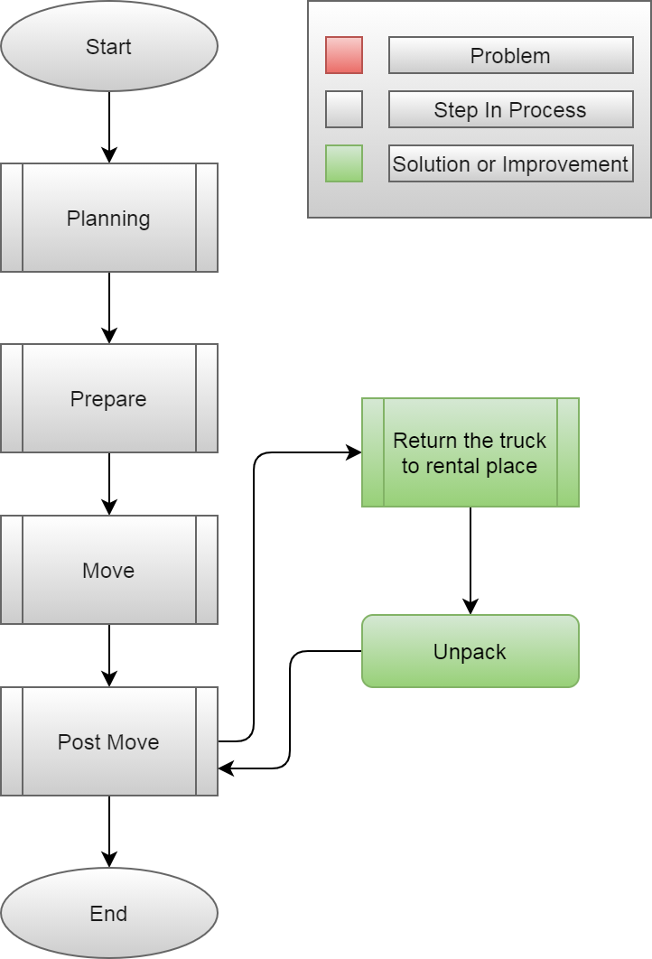

Slide 22
What are the major functional components?

Slide 23
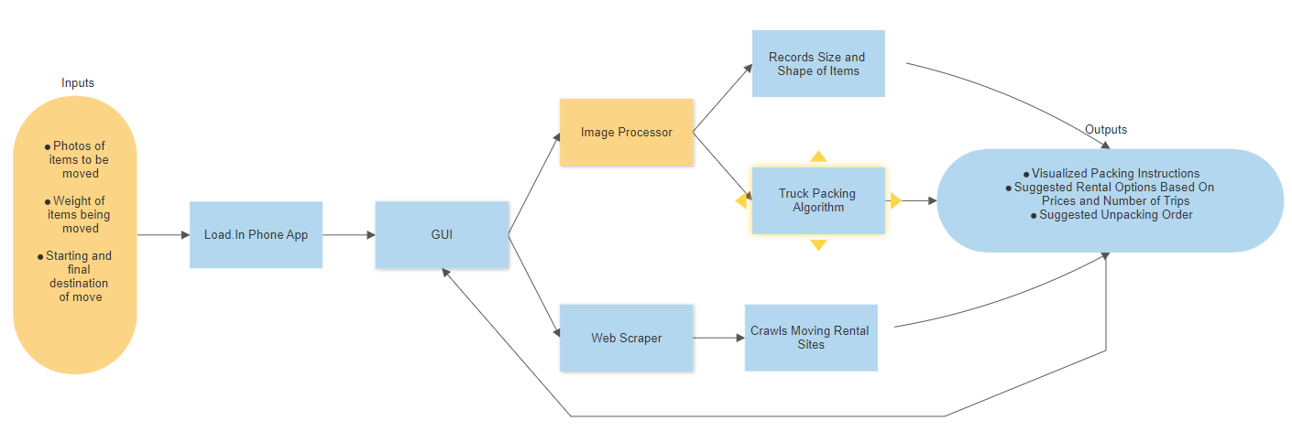

Slide 24
Feasibility Analysis

Slide 25
Per the rubric, add “Description of what proposed solution will do” here

Slide 26
Per the rubric, add “Description of what proposed solution will NOT do” here

Slide 27
Per the rubric, add “Market analysis & benefits to the customer base” here

Slide 28
Risks & Mitigation

Slide 29
Customer Risks
Customer deviates from application instructions
Damaged Items
Damage to Property (building damages)
Personal Injury
Insufficient Experience
Security

Slide 30
Technical Risks
AI: Low training data
Server down time
Application non-performant
Poor system architecture
New, Unproven Technology
UI design
Inability to quickly implement user feedback due to technical complexity

Slide 31
What’s the competition like?

Slide 32
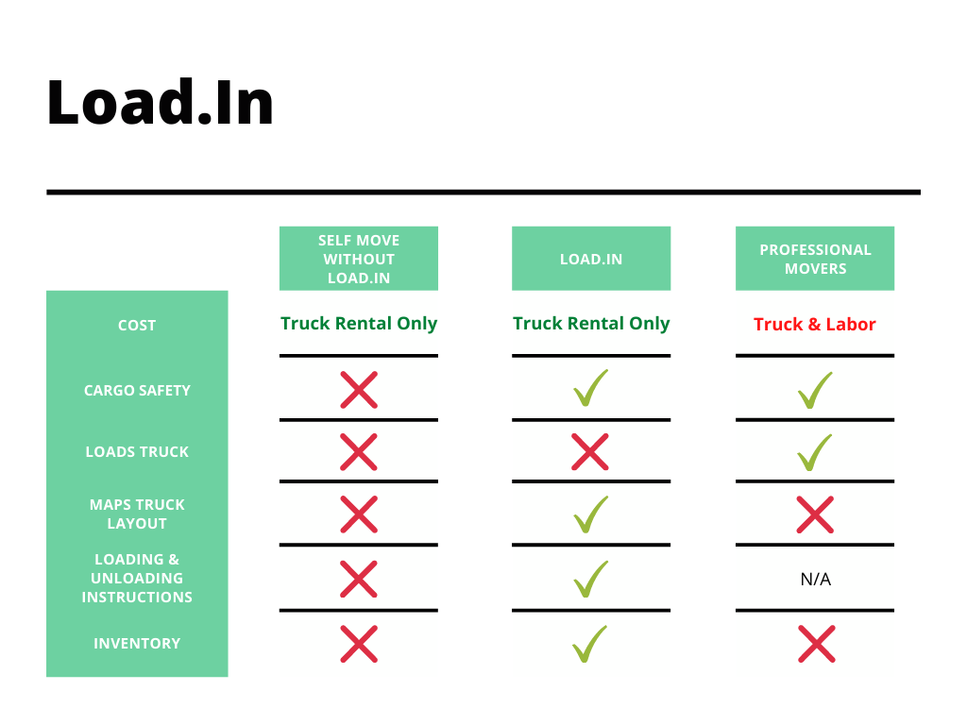

Slide 33
Notes:
End of presentation.

Slide 34
Sources:
The Top 5 Moving Mistakes Across America. (2019, August 13). Article. https://www.article.com/blog/top-5-moving-mistakes/
Economy Moving & Storage, LLC. (2015, January 4). How to properly pack and load a moving truck- Movers Cincinnati. YouTube. https://www.youtube.com/watch?v=rjmofUZOdwo&feature=youtu.be
CADCode Systems. (n.d.). Optimizing & Machining | CADCode Systems. CADCode.Com. Retrieved September 20, 2020, from https://www.cadcode.com/category/categories/optimizing-machining
Dube, E. (2020, September 20). OPTIMIZING THREE-DIMENSIONAL BIN PACKING THROUGH SIMULATION. Semantics Scholar. https://www.semanticscholar.org/paper/OPTIMIZING-THREE-DIMENSIONAL-BIN-PACKING-THROUGH-Dube/bb9986af2f26f7726fcef1bc684eac8239c9b853#references
Knoblauch, M. (2019, May 8). One in ten Americans would prefer a week in jail over moving. New York Post. https://nypost.com/2019/05/08/one-in-ten-americans-would-prefer-a-week-in-jail-over-moving/
The American Institute of Stress. (n.d.). The Holmes-Rahe Stress Inventory PDF. Retrieved September 20, 2020, from https://www.stress.org/wp-content/uploads/2019/04/stress-inventory-1.pdf
Wood, T. (2020, January 6). Moving Industry Statistics. MoveBuddha. https://www.movebuddha.com/blog/moving-industry-statistics/
Nat and Friends. (2017, April 18). Google Earth’s Incredible 3D Imagery, Explained. YouTube. https://www.youtube.com/watch?v=suo_aUTUpps&feature=youtu.be
Collins, T. (2018, April 20). A Look Into Photogrammetry and Video Games - Tiger Collins. Medium. https://medium.com/@homicidalnacho/a-look-into-photogrammetry-and-video-games-71d602f51c31

Slide 35
Glossary:
*All definitions are sourced from Wikipedia
Photogrammetry
Photogrammetry is the science and technology of obtaining reliable information about physical objects and the environment through the process of recording, measuring and interpreting photographic images and patterns of electromagnetic radiant imagery and other phenomena.
Algorithm
A finite sequence of well-defined, computer-implementable instructions, typically to solve a class of problems or to perform a computation.
Professional movers
Professionals who move all your belongings for you from one place to another.
Packing problems
Are a class of optimization problems in mathematics that involve attempting to pack objects together into containers. The goal is to either pack a single container as densely as possible or pack all objects using as few containers as possible.

Slide 36
Americans Prefer to Move Themselves

Slide 37
Truck rental companies offer a variety of helpful moving supplies, but when it comes to the actual move, will only refer you to unaffordable professional movers. As a result, “Do It Yourself” movers are often left to fend for themselves in managing moving logistics and uncertainties with little prior experience. Load.In aims to give your move a game plan by quantifying uncertainties and assisting in logistical endeavors on moving day.

Slide 38
Professional Movers Are Costly
Based on 4 Movers at Average rate of $50/HR to $100/HR
https://www.mymovingreviews.com/move/average-moving-cost/

Slide 39
78.3% of Americans go without the help of professional movers.
MoveBuddha.com

Slide 40
35% of Americans are stressed the most by logistics and packing.
Article.com

